Slide 1
Supercharging Github Copilot
Building custom VS Code extensions

Slide 2

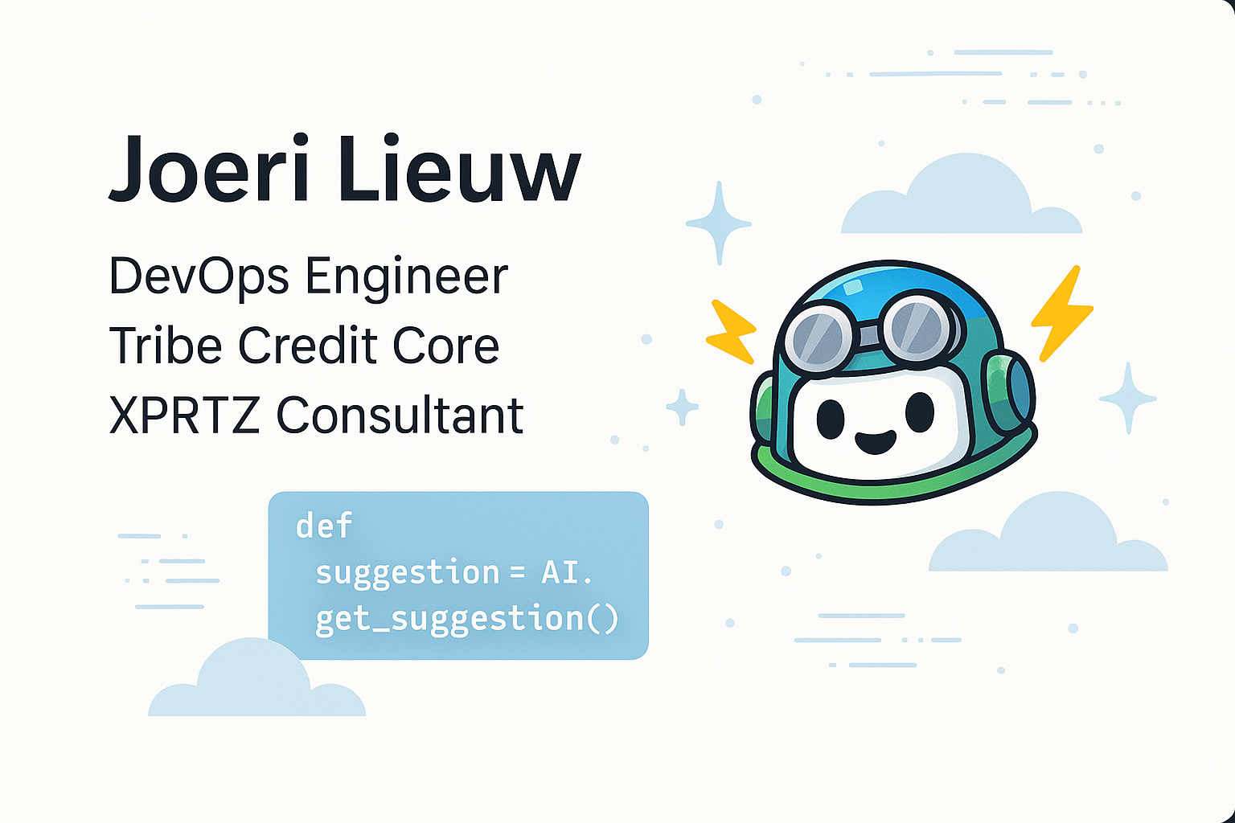
Intro

Slide 3
Goal
Getting the most out of Github Copilot
Showing the potential of LLM tools
Notes:
First we’ll go through some AI Concepts, then in a live demo I will show how to create an extension for VS-Code. And we’ll see how to implement some of the AI concepts in VS-Code using Github Copilot.

Slide 4
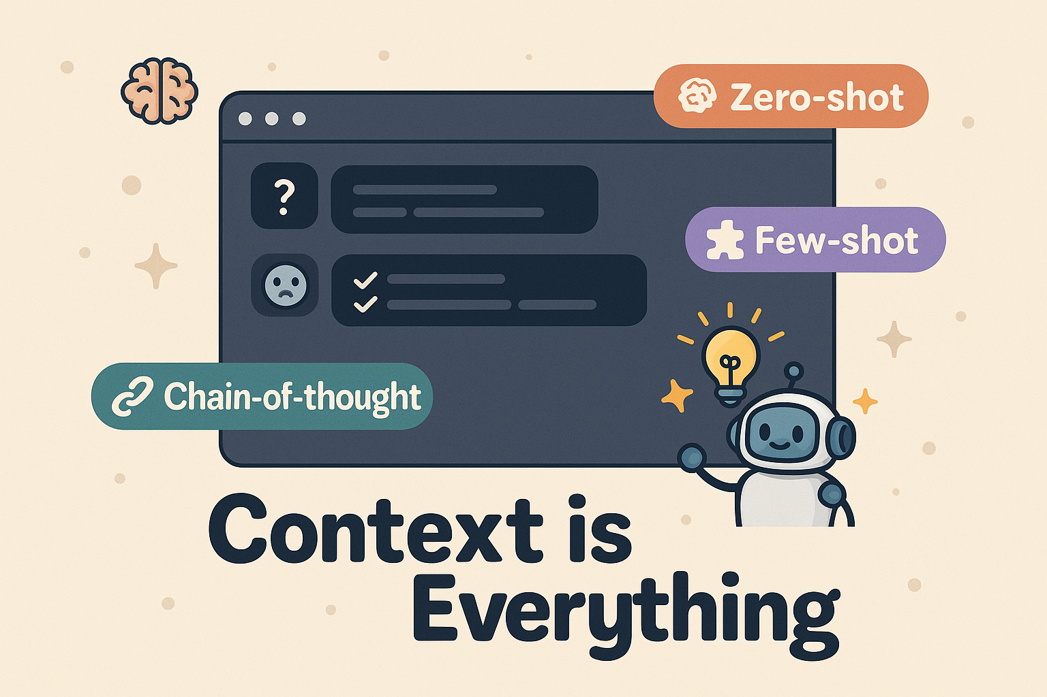
The Basics!
Prompt Engineering
Notes:
I know most of you are already familiar with prompt engineering—so I’ll keep this tight.
In essence, prompt engineering is the craft of structuring inputs to get useful outputs from an LLM. But the key idea I want to emphasize here is: context matters.
The quality of a model’s response is almost entirely dependent on what it knows when you ask it something. So prompt engineering isn't just about clever phrasing—it's about ensuring the right context is available at the right time.
That’s why this concept kicks off our AI section. Everything else we’ll talk about—embeddings, tool calling, MCP servers—are basically different ways to inject better, richer, more relevant context into the prompt.
Prompt engineering is the foundation. The rest are delivery mechanisms. Think of it like this: the model is only as good as the prompt—and the prompt is only as good as the context it contains.

Slide 5
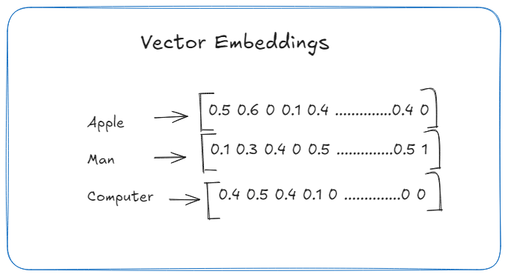
Vector Embeddings
Notes:
Let’s talk about embeddings—this is the secret sauce behind smart semantic search and retrieval in AI tools like Copilot.
At their core, embeddings are just vectors—a list of numbers—that represent the meaning of a piece of text or code. Instead of working with the literal words, the model works with a numerical encoding of the idea behind those words.
Now, the length of that vector, or the number of dimensions, depends on the embedding model. For example:
OpenAI’s text-embedding-ada-002 returns 1536 dimensions.
Other models might use 512 or even 2048 dimensions.
Each dimension represents a specific abstract feature, like topic, tone, structure, or intent—though we don’t usually know exactly what each one means.

Slide 6
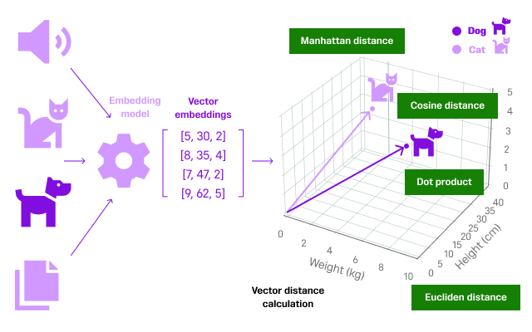
Semantic Search
Notes:
Semantic search vs keyword search. When we feed a query and a document through the same embedding model, we can compare their vectors to see how "close" they are semantically. That’s where vector stores come in.
A vector store indexes these embeddings and allows you to perform semantic search—searching by meaning, not exact words.
Under the hood, it uses mathematical distance functions like:
Cosine similarity: Measures angle between vectors; great for normalized vectors.
Euclidean distance: Measures straight-line distance.
Dot product: Useful when magnitude matters.
These distances tell us how similar two vectors are—and by extension, how similar their meanings are. The lower the distance, the more semantically similar the content.

Slide 7
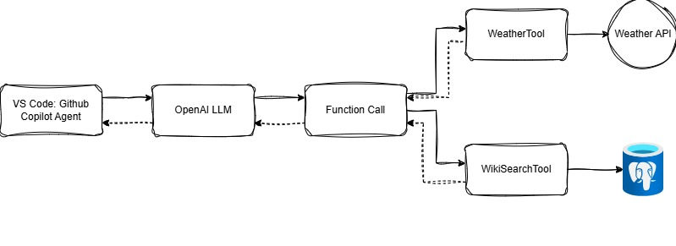
Tool Calling
Notes:
Tool calling is one of the most exciting advancements in LLM-based development—and it’s a game changer for GitHub Copilot in Agent Mode.
Tool calling allows a language model, like GPT, to invoke functions or APIs based on the task at hand. You define your tools—each with a description of what it does and the parameters it expects—and the model decides when and how to use them.
Instead of writing if-else logic or manually wiring tool selection, the LLM becomes the decision-maker.
And the response of those tools is again fed to the LLM as additional context so it can craft a better response to the user.

Slide 8
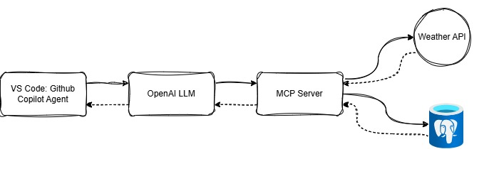
Model Context Protocol
Notes:
The Model Context Protocol (MCP) is an open protocol that enables seamless integration between LLM applications and external data sources and tools. Whether you're building an AI-powered IDE, enhancing a chat interface, or creating custom AI workflows, MCP provides a standardized way to connect LLMs with the context they need.
MCP is a standardized protocol designed to define how language models communicate with tools, APIs, and context providers in a structured, modular way.
Unlike traditional tool calling—where you define a list of tools and the model chooses from them at runtime—MCP formalizes this interaction through a server that speaks the protocol.
So what’s the difference?
In regular tool calling, you register tools locally with descriptions, and the model picks from them based on your query.
With MCP, you have a remote service (the MCP server) that responds to context or tool requests from the LLM. The LLM doesn't need to know all tools up front.
The MCP server dynamically resolves:
What tools or context are available
How to handle the request
What data to return
This enables more scalable, modular, and programmable agent behavior. You can integrate business logic, permission handling, observability, or data routing behind the scenes—without changing the model interface.

Slide 9
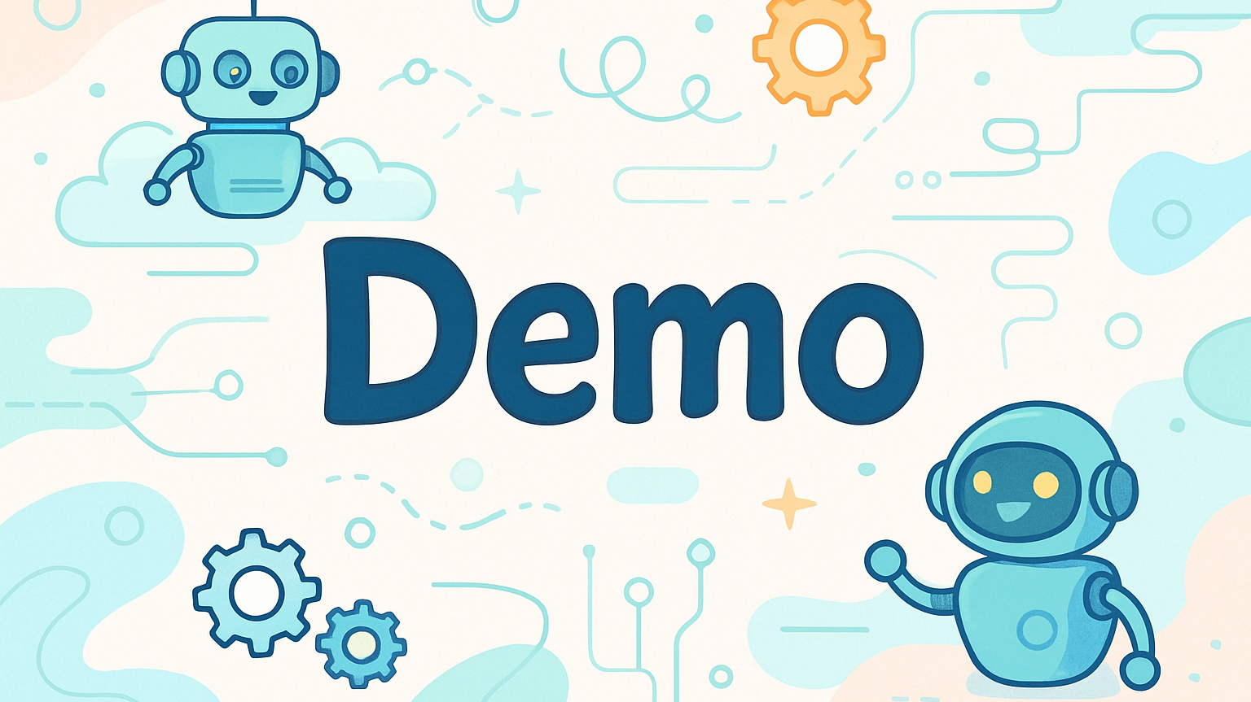

Slide 10

Thank you for your attention!
Questions?

Slide 11
Speaker tips
Tips:
Craft a clear story that is tailored to your audience. What’s the essence of your story? What do you want your audience to do, feel or remember? How to you end the presentation, a short summary (max 3. items to remember), a quote or a call-to-action?
Think beforehand about how to engage your audience. Online presentations require more effort to keep your audience engaged. Regularly interact with them by asking questions and encouraging participation.
Make sure to use clear visuals and high-contrast colours in presentations. This makes your content accessible and easy to understand, also for those with visual impairments.
Do you…
Need tips on how to give a powerful presentation? Use Mark Robinson’s presentation format. Find the explanation in this short (18 min.) Ted Talk .
Want to practice your presentation skills and improve your speaking skills? Organize a Speakers Academy session or join the workshop (March 5).
Need support on standard communication materials (such as templates, images, visuals etc.)? Go to The Brand Portal.
Want to make your presentation interactive? Use breakout rooms or RaboVote. Find an explanation here.
For all other speaker information, please go to the speakers page.

Slide 12




How to use this deck
Edit the slides in whatever way you like. You can stick to the standard or personalize your presentation. Engineer’s Week is all about your knowledge, input & creativity, so feel free to customize the slides to fit your story.
Be aware no to include any sensitive information!
Add a new slide by clicking the ‘new slide’ button in the home menu. Here, you can choose one of the many template slides available.
Add icons, illustrations, photography etc. with the templafy plug-in or download them from the Brand Portal.
This plug-in is installed by default. Is the button not visible? Go to file → options → add-ins → click Templafy PowerPoint Add-in → go → select Templafy box → ok.

